Slide 1
Curriculum Inventory Management (CIM) Software Training

Slide 2
Logging In
URL for courses
URL for programs
You will use your UM ID/password for logging in.

Slide 3
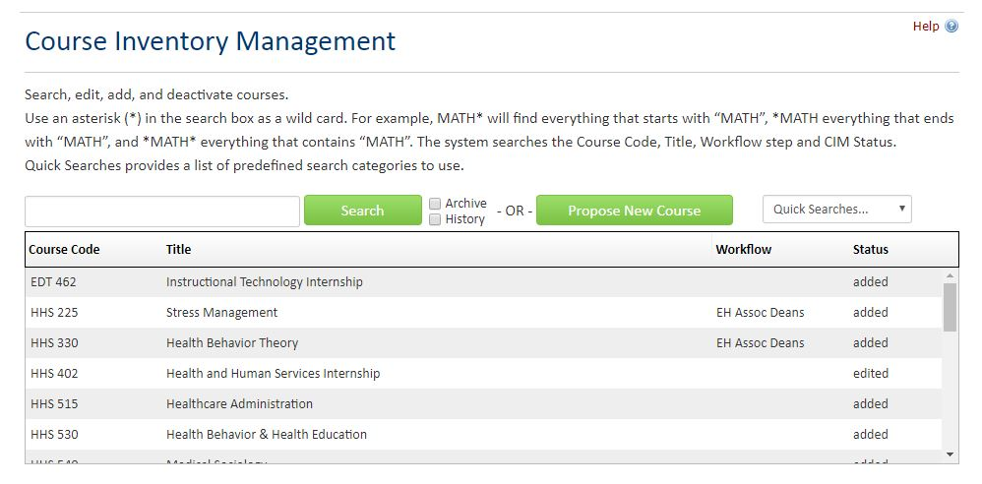
Searching for a Course
You are able to search for existing courses from the homepage.

Slide 4
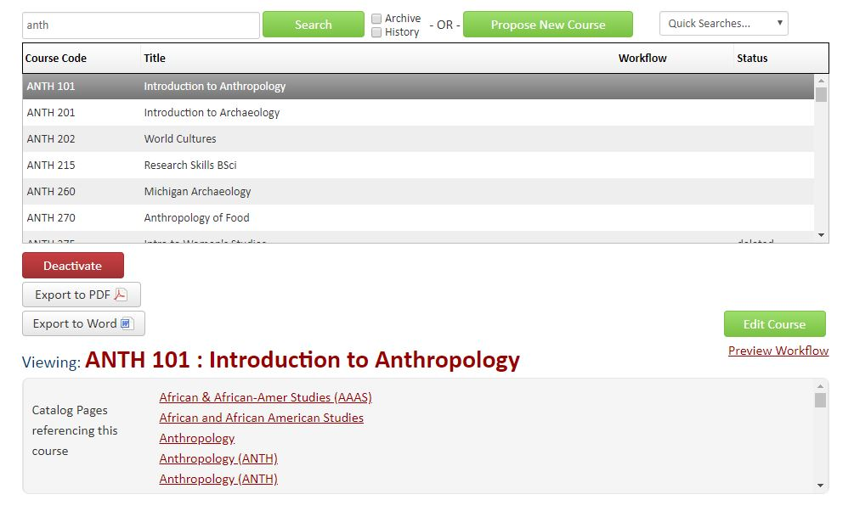
Editing a Course
You can propose edits to courses once you’ve clicked on the specific course – edits will trigger the course to go through the workflow.

Slide 5
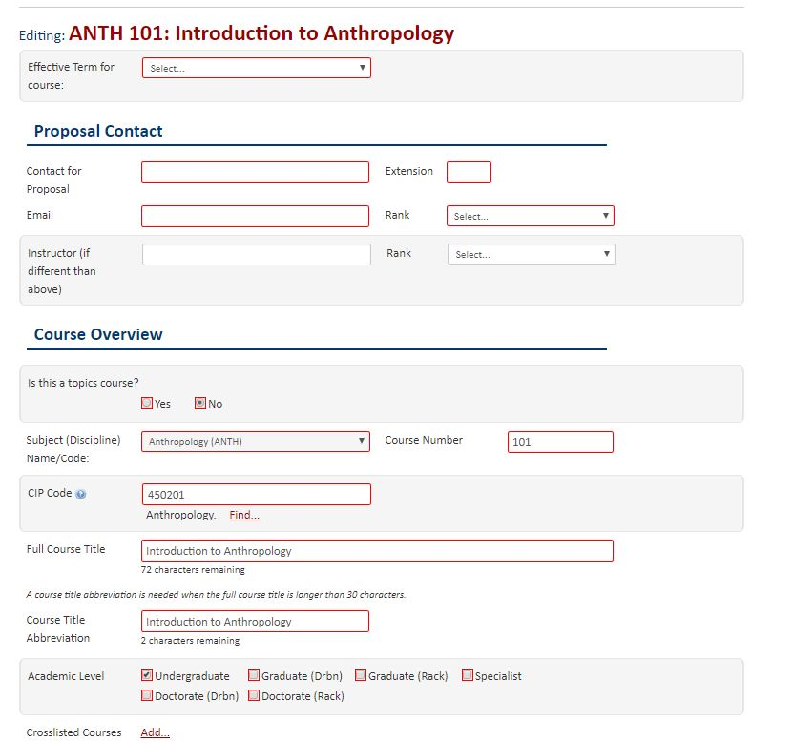
Editing a Course
When editing a course, the fields will pre-fill with the most up-to-date information, allowing you to only change the necessary information.

Slide 6
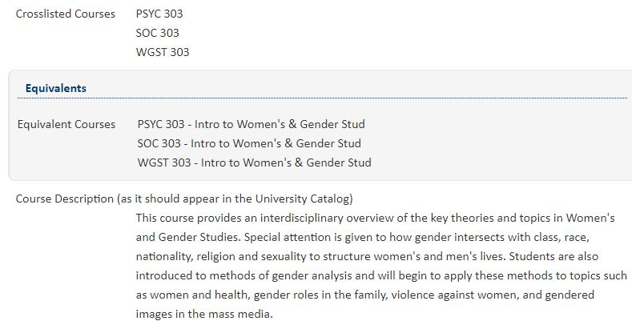
Cross-Listed Courses
Cross-listed and Equivalent Courses will be listed on this form.
Please note: For courses that are cross-listed at different levels – changes will have to be made in both undergrad/grad in order to be reflected. Also, when deactivating a cross-listed course, it will not automatically deactivate all cross-lists.

Slide 7
Deactivating a Course
Deactivating a course will also trigger the workflow to begin – you are able to do that using the red button on the right-hand side of the course form.

Slide 8
Proposing a New Course
You are able to propose a new course from the homepage. Anyone with access to CIM is able to propose a new course.

Slide 9
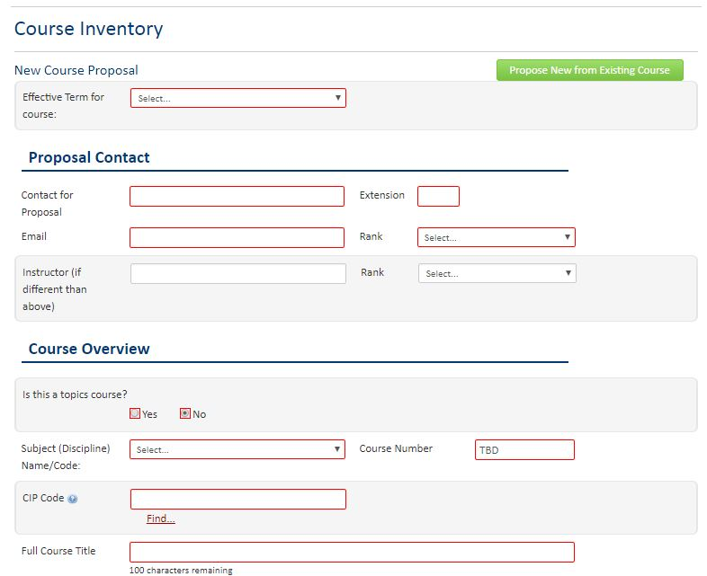
Proposing a New Course
When proposing a new course, all fields outlined in red are required. The information required is similar to that used in the PDF forms now. You can also pre-fill the form by using the Propose New from Existing Course button.
NOTE: CIP Codes can be found by using the Find function directly below and searching for the discipline.

Slide 10
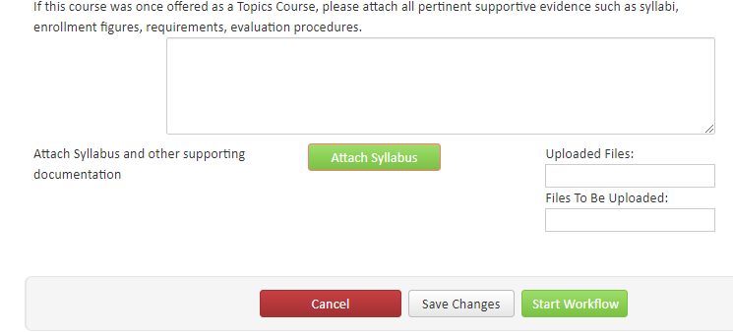
Attaching Files
You are able to attach syllabi (and other supporting documents) to both edited and new course proposals.

Slide 11
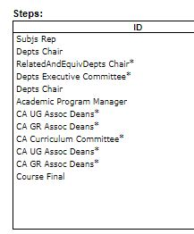
Workflow for Courses
Each college’s workflow has been set-up to align with the current curriculum process that is followed. Once a course is approved at the current step in the workflow, it will then be triggered to move on to the next tier, and those who need to approve will receive an email notification.

Slide 12
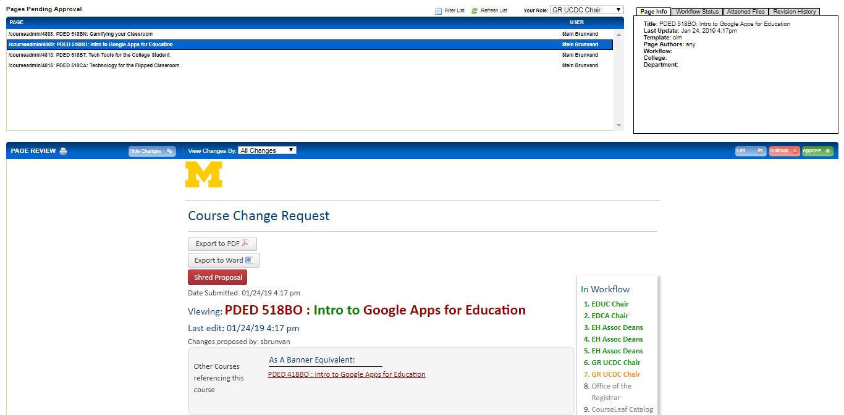
Approving a Course
When a course is awaiting your approval, you will receive an email with the link leading you to approve it.
You can also access your approval page by using this link.

Slide 13
Approving a Course
You will have to indicate your role in the top right-hand corner drop down box, depending on the step in the workflow (you may have multiple). All proposals waiting on your approval (in that role) will appear here.

Slide 14
Approving a Course
Once you choose a proposal, you will have the option to Edit (making changes yourself), Rollback (to a specific Workflow role), or Approve (as is).

Slide 15
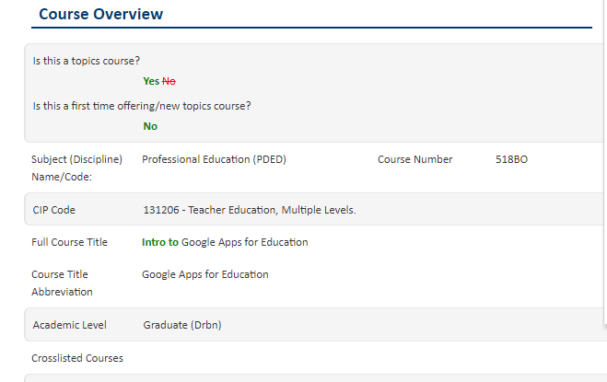
Approving a Course
Changes to an edited course will appear in Green and edits will appear in red throughout the proposal.
NOTE: Editing the course does not automatically alert the proposer/previous approvers, so if making major edits you will want to notify the proper channels.

Slide 16
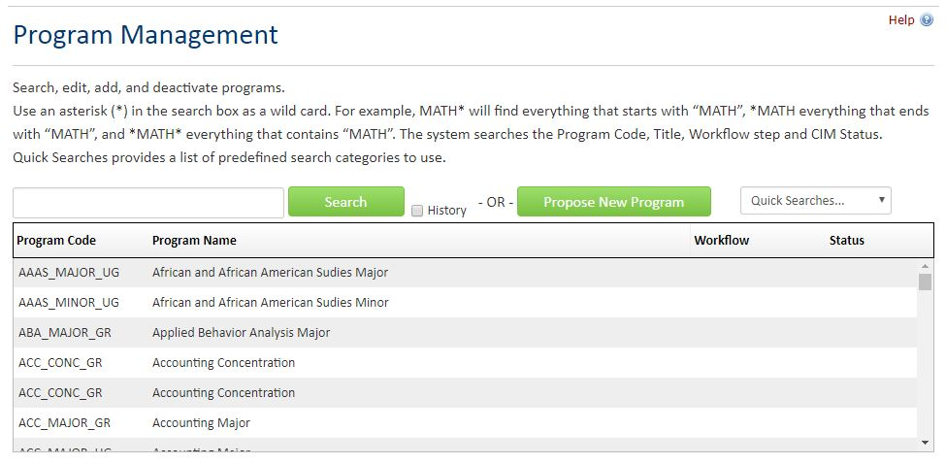
Programs
The steps for the Program Management site will be the same as the Course Management site – just a different URL.

Slide 17
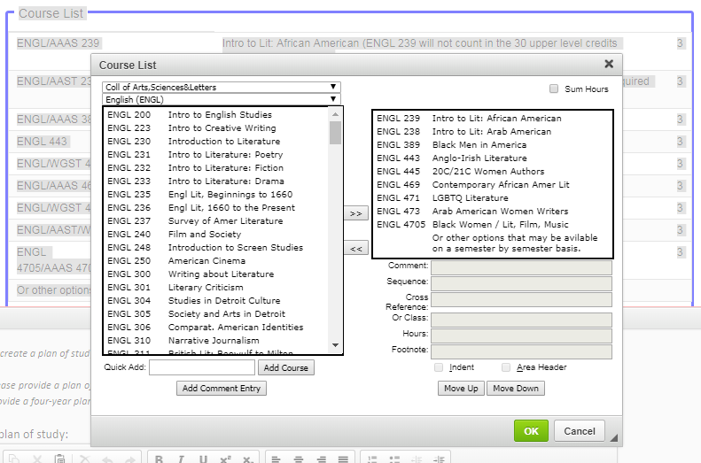
Programs
In the Program Outline section, if you need to change the course list, you are able to do so by double clicking the table.
Please do not delete the entire table!

Slide 18
DDC & CIM
DDC applications are not going to be processed through CIM at this time. Please continue applying via the PDF forms, found on our website:

Slide 19
Questions?
cimquestions@umich.edu
Check out our webpage for updates & further training materials

